Slide 1
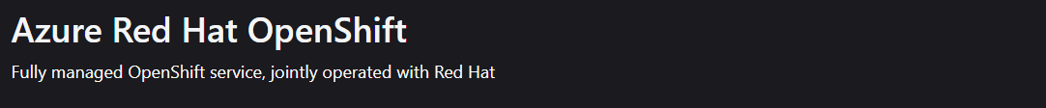
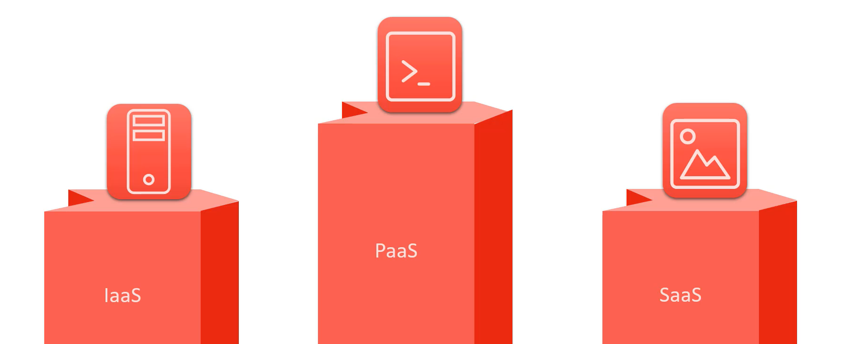

Slide 2
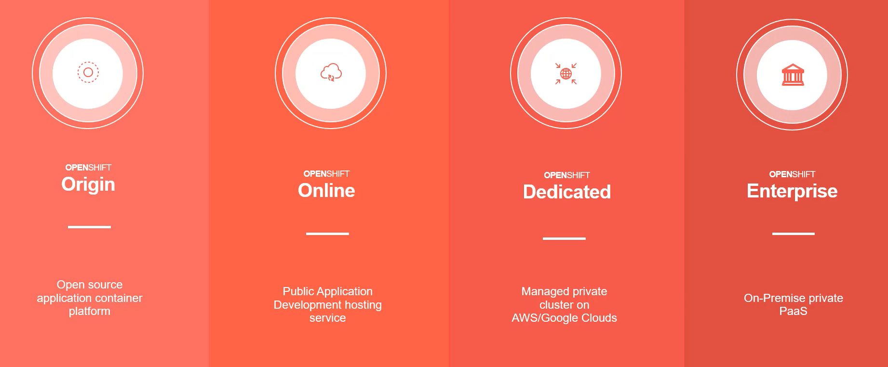

Slide 3
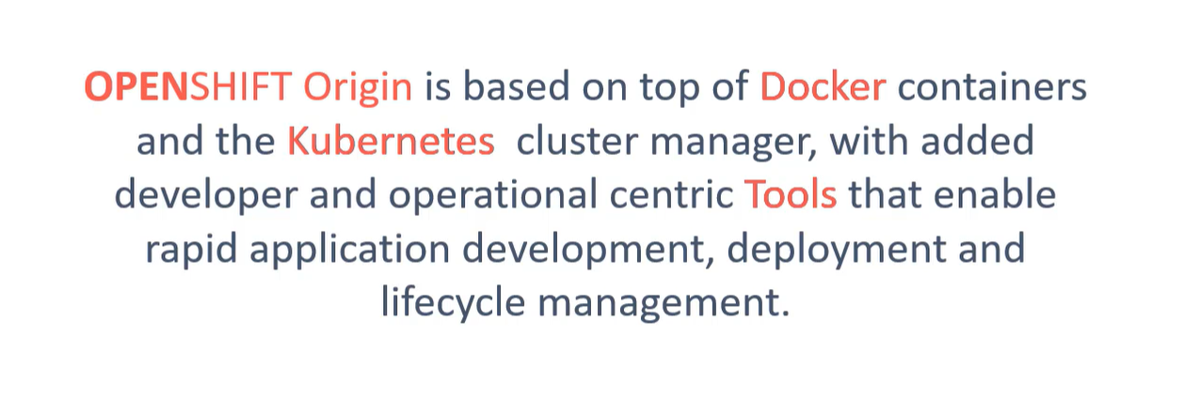

Slide 4
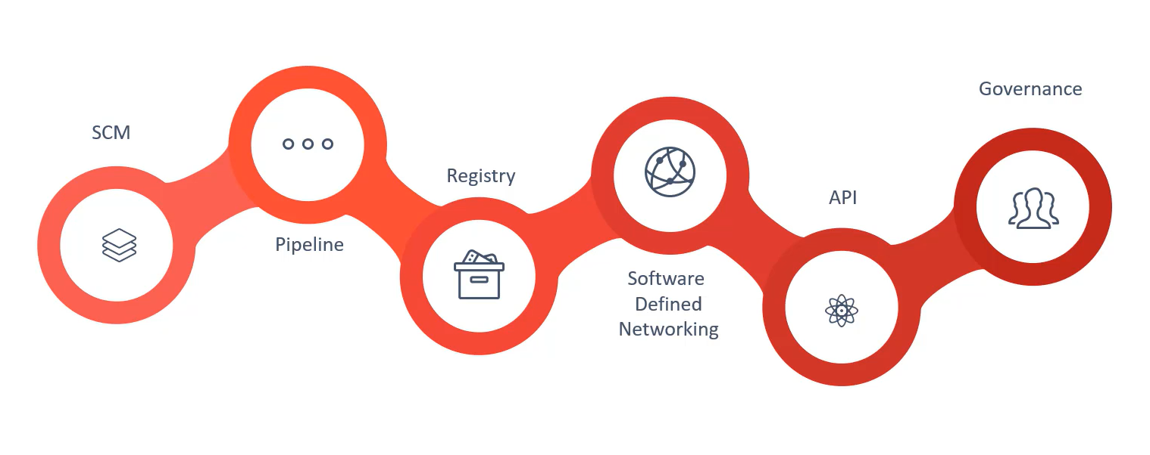

Slide 5
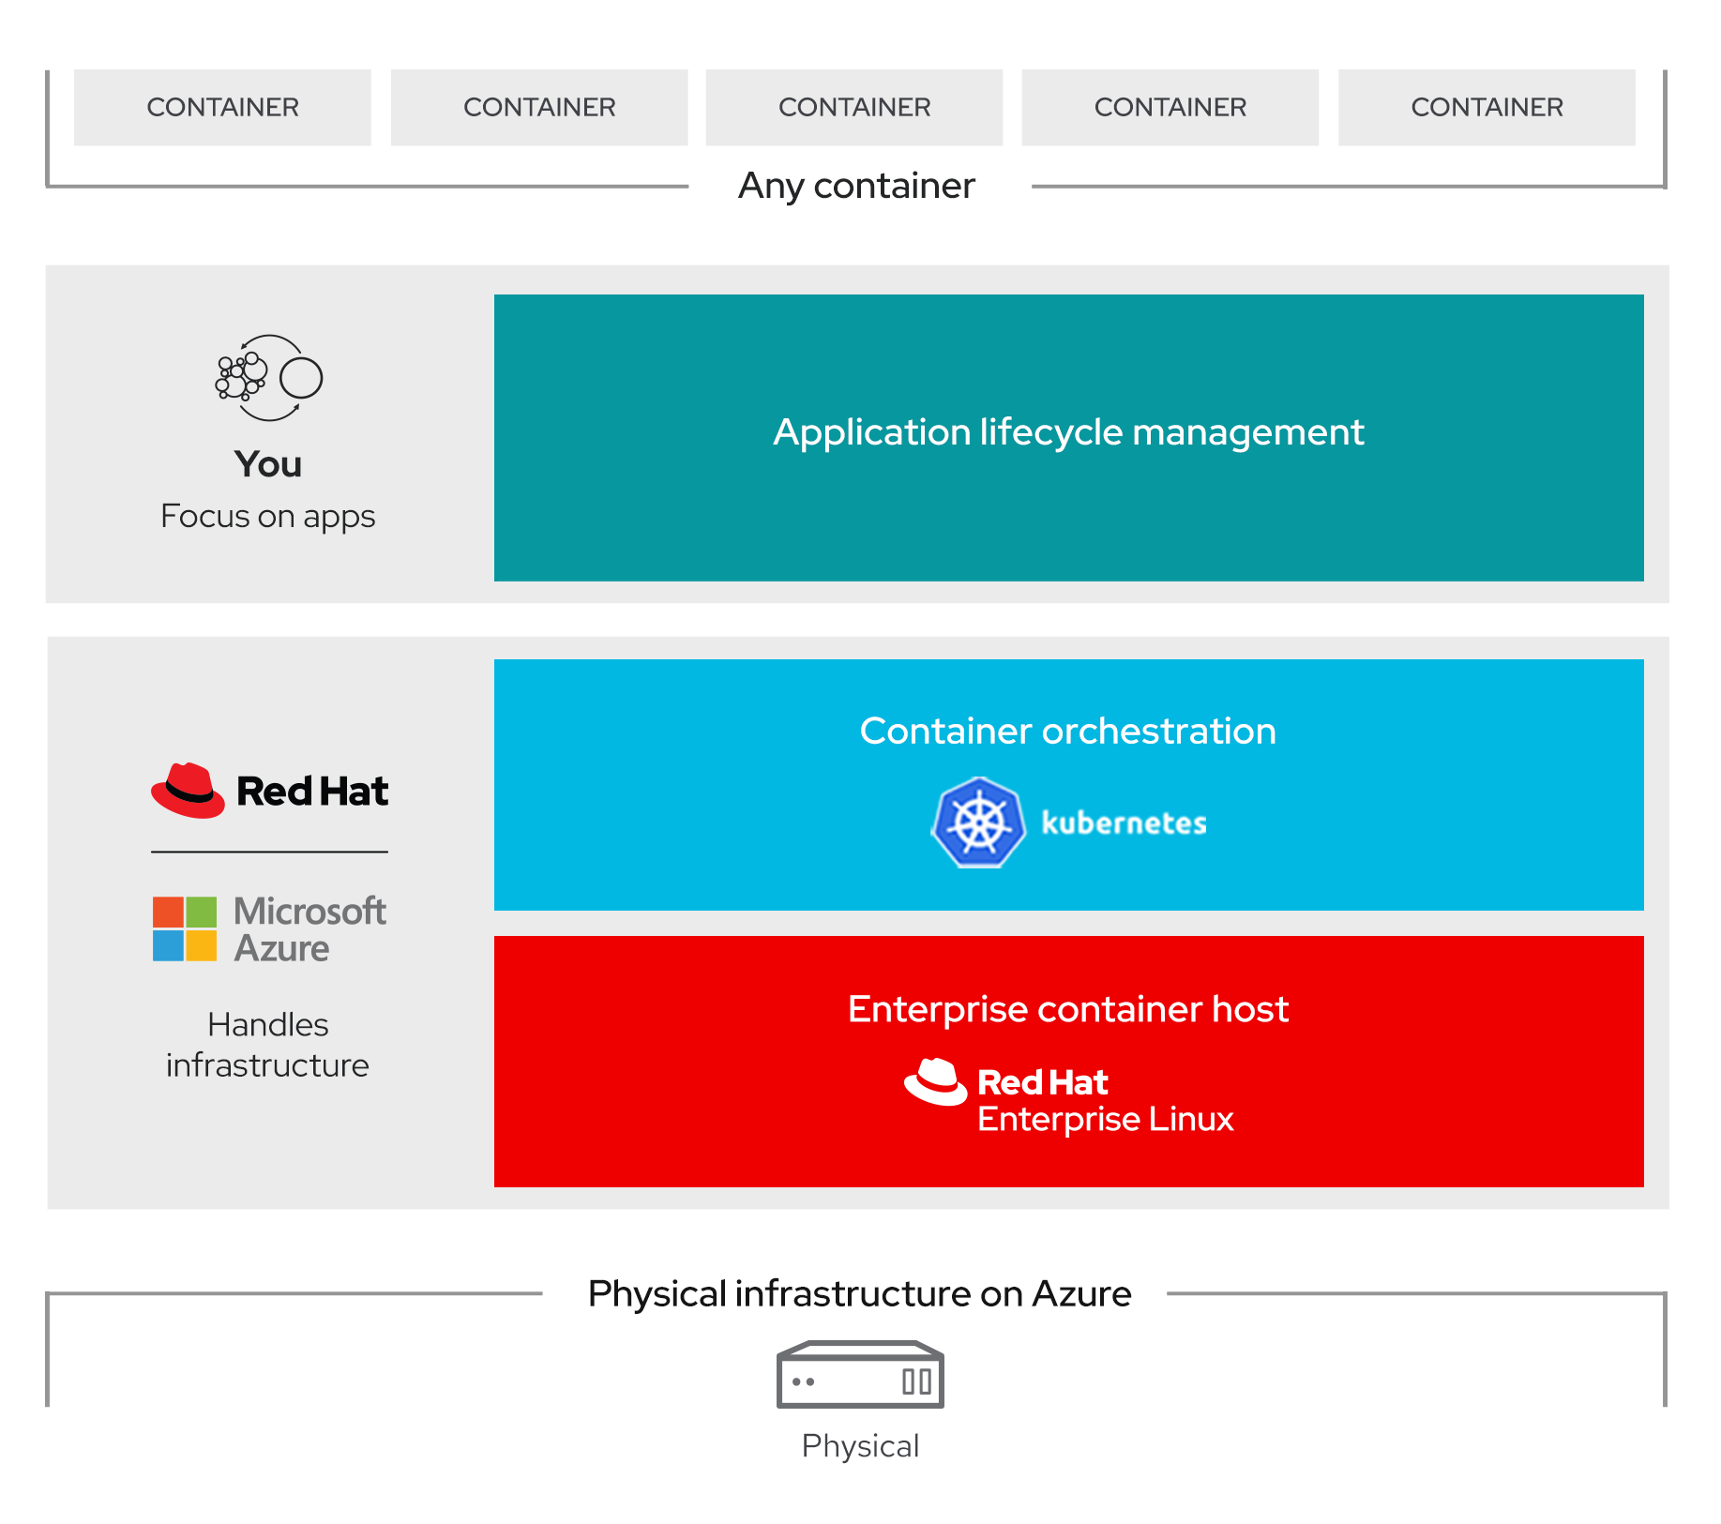
ARO

Slide 6
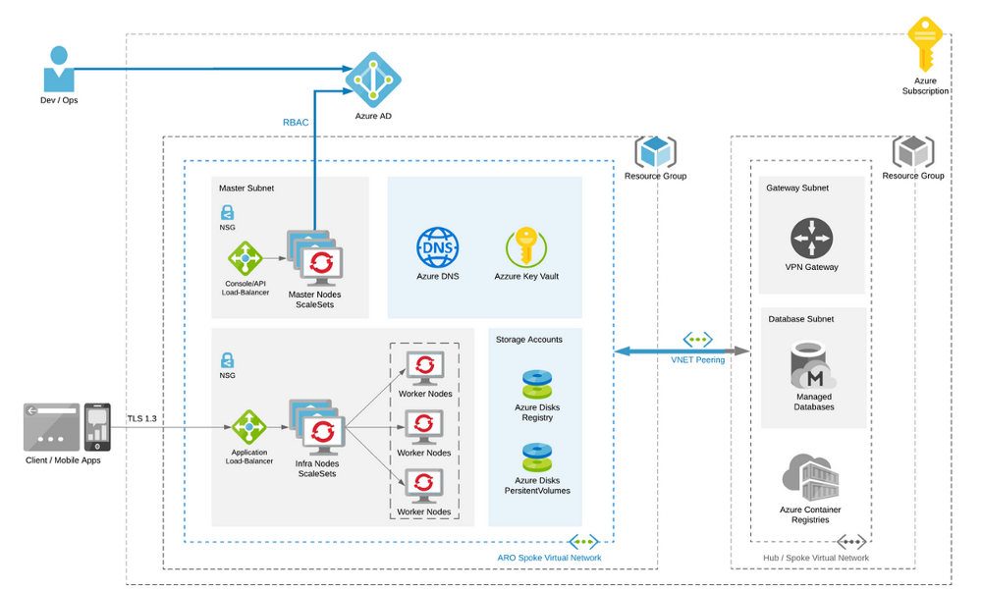

Slide 7
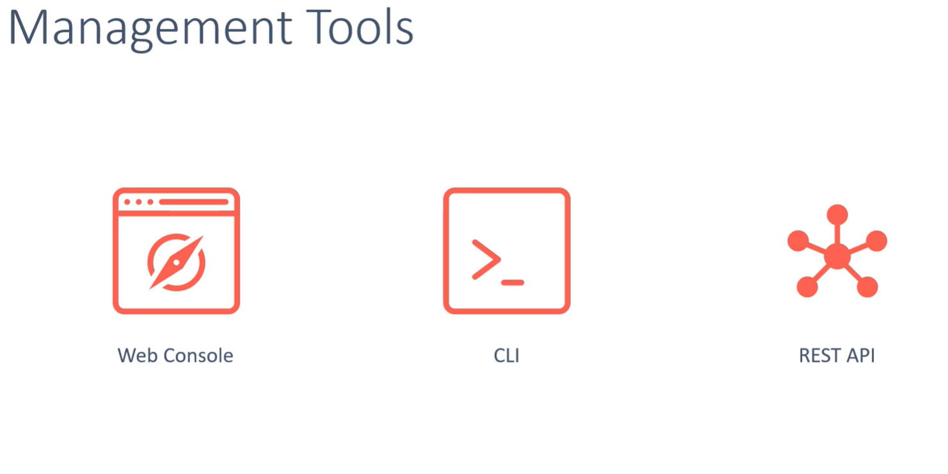

Slide 8
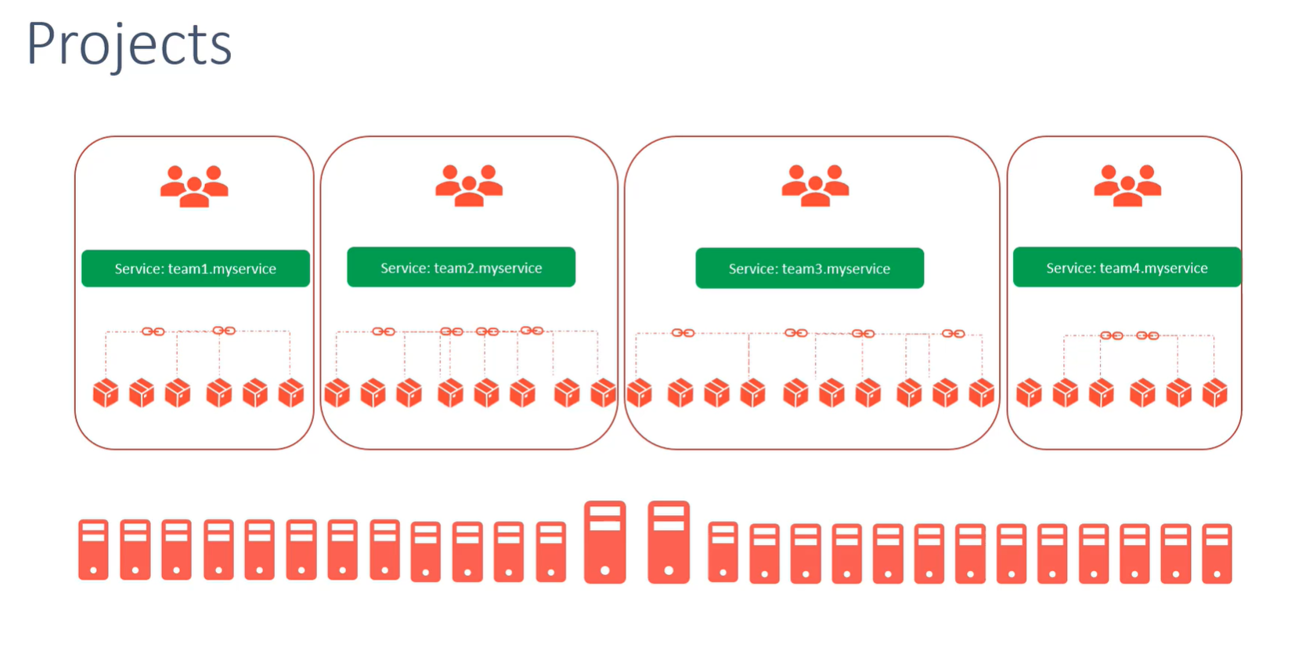

Slide 9
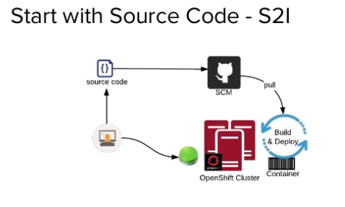
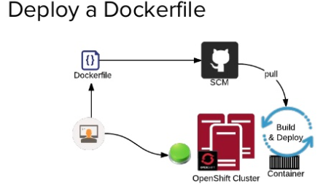
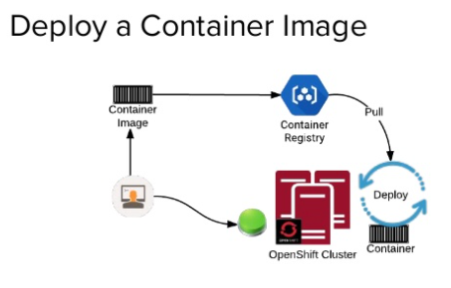

Slide 10
Step-1 Verify your permissions
You must have either Contributor and User Access Administrator permissions, or Owner permissions, either directly on the virtual network, or on the resource group or subscription containing it.
You will also need sufficient Azure Active Directory permissions for the tooling to create an application and service principal on your behalf for the cluster.

Slide 11
Step-2 Register the resource providers
az account set --subscription <SUBSCRIPTION ID>
az provider register -n Microsoft.RedHatOpenShift --wait
az provider register -n Microsoft.Compute --wait
az provider register -n Microsoft.Storage --wait

Slide 13
Step-3 Script to Deploy
LOCATION=eastus
# the location of your cluster
RESOURCEGROUP=Marutiaro-rg
# the name of the resource group where you want to create your cluster
CLUSTER=cluster1
# the name of your cluster

Slide 14
az group create \
--name $RESOURCEGROUP \
--location $LOCATION
az network vnet create \
--resource-group $RESOURCEGROUP \
--name aro-vnet \
--address-prefixes 10.0.0.0/22

Slide 15
az network vnet subnet create \
--resource-group $RESOURCEGROUP \
--vnet-name aro-vnet \
--name master-subnet \
--address-prefixes 10.0.0.0/23 \
--service-endpoints Microsoft.ContainerRegistry
az network vnet subnet create \
--resource-group $RESOURCEGROUP \
--vnet-name aro-vnet \
--name worker-subnet \
--address-prefixes 10.0.2.0/23 \
--service-endpoints Microsoft.ContainerRegistry

Slide 16
az network vnet subnet update \
--name master-subnet \
--resource-group $RESOURCEGROUP \
--vnet-name aro-vnet \
--disable-private-link-service-network-policies true
az aro create \
--resource-group $RESOURCEGROUP \
--name $CLUSTER \
--vnet aro-vnet \
--master-subnet master-subnet \
--worker-subnet worker-subnet

Slide 17
Step-4 Connecting to Cluster
az aro list-credentials \
--name $CLUSTER \
--resource-group $RESOURCEGROUP
#output is
{
"kubeadminPassword": "j55qR-txikY-y3VAN-TPLkU",
"kubeadminUsername": "kubeadmin"
}
https://console-openshift-console.apps.swmul8kz.eastus.aroapp.io/

Slide 18
If you're running the commands on the Azure Cloud Shell, download the latest OpenShift 4 CLI for Linux.
cd ~
wget https://mirror.openshift.com/pub/openshift-v4/clients/ocp/latest/openshift-client-linux.tar.gz
mkdir openshift
tar -zxvf openshift-client-linux.tar.gz -C openshift
echo 'export PATH=$PATH:~/openshift' >> ~/.bashrc && source ~/.bashrc
Retrieve the API server's address.
apiServer=$(az aro show -g $RESOURCEGROUP -n $CLUSTER --query apiserverProfile.url -o tsv)
oc login $apiServer -u kubeadmin -p <kubeadmin password>

Slide 19
Step-5 Delete the Cluster
Delete the cluster
CLUSTER=cluster1
RESOURCEGROUP=Marutiaro-rg
az aro delete --resource-group $RESOURCEGROUP --name $CLUSTER

Slide 20
AKS - ARO

Slide 21
